Slide 1


inode-based File System
SE124 (2022 Fall)
Yubin Xia
IPADS, Shanghai Jiao Tong University
https://www.sjtu.edu.cn

Slide 2
Large-scale websites are built from distributed systems
DataBase，FileSystem等是stateful的，需要存储每一个state，所以存在数据同步问题
stateful处理：三备份(投票机制)
While distributed systems are built from components on a single node
File system runtimes, etc.
Caching server
Caching server
Caching server
…
Caching
Caching
Caching
Distributed caching
Database server
Database server
CDN
Users
Application #1
generate the page
Database
user, price
…
Database
user, price
Application server
Distributed database
Internet
Load
Balance
Application #2
add the order
File server
File server
File server
File:
image
File:
image
…
File:
image
Application server
…
…
Message queue
Distributed file system

Slide 3
Large-scale websites are built from distributed systems
While distributed systems are built from components on a single node
File system runtimes, etc.
Caching server
Caching server
Caching server
…
Caching
Caching
Caching
Distributed caching
Database server
Database server
CDN
Users
Application #1
generate the page
Database
user, price
…
Database
user, price
Application server
Distributed database
Internet
Load
Balance
Application #2
add the order
File server
File server
File server
File:
image
File:
image
…
File:
image
Application server
…
…
Message queue
Distributed file system

Slide 4
iNode-based File System

Slide 5

What is a file?
Storage as files
A file has two key properties:
It is durable & has a name
It is a high-level version of the memory abstraction
System layer implements files using modules from hardware layer
Divide-and-conquer strategy
Makes use of several hidden layers of machine-oriented names (addresses), one on another, to implement files
Maps user-friendly names to these files
durable：持久性
分而治之策略

Slide 6
The Big Picture
block的大小一般都是4kb
User
App-1
App-2
App-3
OPEN("a.txt", "rw")
READ(…)
WRITE(…)
…
File System
Kernel
File一般是存储在disk上面的，
但是也会使用memory。
Disk Driver
READ(block-addr, buf)
WRITE(block-addr, buf)
Hardware
Memory
Disk
(4TB = 2³⁰ x 4KB blocks)

Slide 7
Abstraction: API of UNIX File System
OPEN, READ, WRITE, APPEND, SEEK, CLOSE
FSYNC
STAT, CHMOD, CHOWN
RENAME, LINK, UNLINK, SYMLINK
MKDIR, CHDIR(cd), CHROOT
MOUNT, UNMOUNT
….
SEEK：用于移动cursor(游标)

Slide 8
A Naive File System
Each file occupies one continuous range of blocks
Use block index as file name, e.g., 107, 113
Every file write will either append or reallocate
What are the problems?
101
102
103
104
105
106
107
108
109
110
111
112
113
114
115
116
117
118
119
120
problems:1.可能会出现block不够的情况，需要扩容
2.可能会出现严重的碎片化，导致disk利用率低下
3.在进行reallocate时，不好同步(即修改文件位置之后
，想要使得上层程序知道修改后的新位置是较难的)

Slide 9
inode: 7 software layers

Slide 10
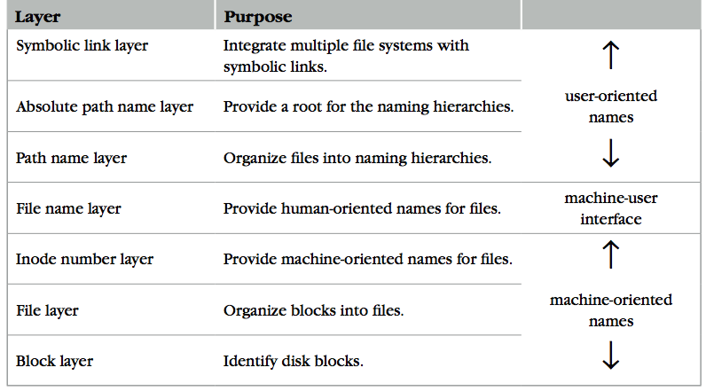
The Naming Layers of the UNIX FS (version 6)
Notes:
TODO: redraw

Slide 11

L1: Block Layer
Block num
Disk
Block
Mapping: block number -> block data
How to know the size of block?
How to know which block is free?
These metadata will also be stored on the same disk
Super block!
procedure BLOCK_NUMBER_TO_BLOCK(integer b)-> block
return devices[b]
每个文件系统有自己的super block

Slide 12
Super Block
Block num
Disk
Block
One superblock per file system
Kernel reads superblock when mount(挂载) the FS
Superblock contains:
Size of the blocks
Number of free blocks
A list of free blocks
Other metadata of the file system (including inode info)
使用bitmap来存储free blocks的id，superblock只记录了
起点
Boot Block：用于启动的block
每个file System有一个super block。
0
1
…
n - 1
Boot
block
Super
block

Slide 13
L1: Block Layer
Block num
Disk
Block
Block size: a trade-off
Neither too small or too big
Question
What will happen if the block size is too small? What if too big?
How to efficiently track free blocks?
blockSize过大：会产生碎片化，而且可能会出现利用率很低的情况
blockSize过小：需要记录的metadata可能过多

Slide 14
L1: Block Layer
Block num
Disk
Block
Block size: a trade-off
Neither too small or too big
Question
What will happen if the block size is too small? What if too big?
How to efficiently track free blocks?
Use a bitmap
File blocks
0
1
…
余量
n - 1
Boot
block
Super
block
Bitmap for free blocks

Slide 15
L2: File Layer
File
(inode)
Block num
Disk
Block
File requirements
Store items that are larger than one block
May grow or shrink over time
A file is a linear array of bytes of arbitrary length
Record which blocks belong to each file
inode (index node)
A container for metadata about the file
block_nums记录的是inode对应文
件的存储的block的编号集合，
size存储的是文件总大小。
N表示的是文件最大的block个数
文件系统中inode大小固定
struct inode
integer block_nums[N]
integer size

Slide 16
inode for Larger Files
File
(inode)
Block num
Disk
Block
较大的文件使用多级页表(类似于ICS中的)来减小
单个inode的占用空间大小。注意对于indirect block
虽然只占据block_nums数组中的一位，但是其对应的
block也存储了一系列的block_id用来存储文件内容
block
indirect block
double indirect block
triple indirect block
Data
Data
Data
有了indirect-block，
会在单个inode大小
几乎不变情况下增加
size最大上限。
Data
an inode
Data
Data
Notes:
with a 512 byte block size, and 4 byte block pointers, each indirect block can consist of 128 (512 / 4) pointers.
For one double indirect block: (128*128*512) / (1024*1024)

Slide 17
L2: File Layer
File
(inode)
Block num
Disk
Block
Given an inode, can map a block index number (of a file) to a block number (of a disk)
Index number: e.g., the 3rd block of a file is number 78
procedure INODE_TO_BLOCK(integer offset, inode i)-> block
o <- offset / BLOCKSIZE
b – INDEX_TO_BLOCK_NUMBER(i,o)
return BLOCK_NUMBER_TO_BLOCK(b)
procedure INDEX_TO_BLOCK_NUMBER(inode i, integer index)-> integer
return i.block_nums[index]

Slide 18
L3: inode Number Layer
Inode num
File
(inode)
Block num
Disk
Block
Mapping: inode number -> inode
inode table: at a fixed location on storage
inode number is the index of inode table
Track which inode number are in use, e.g. free list, a field in inode
inode table中存储的是一系列的inode
number，每个num对应于一个file
procedure INODE_NUMBER_TO_INODE(integer num)-> inode
return inode_table[num]
inode num中的一些代表的是
dir，dir中存储的是dir下文件名
与inum的映射，所以可以在跳回
inode table做下一级搜索。
inode_block_pos = (blocks_num(block总数))/BPB(每个block中的bitmap位数) + i / IPB(每个block中inode个数) + 2.
0
1
…
n - 1
blocks[inode_
block_pos]+i %
IPB是inode数据在
该block中起始位置
Boot
block
Super
block
Bitmap for free blocks
Inode table

Slide 19
Put Layers so far Together
Inode num
File
(inode)
Block num
Disk
Block
procedure INODE_NUMBER_TO_BLOCK(integer offset, integer inode_number)-> block
inode i = INODE_NUMBER_TO_INODE(inode_number)
o <- offset / BLOCKSIZE
b <- INDEX_TO_BLOCK_NUMBER(i,o)
return BLOCK_NUMBER_TO_BLOCK(b)
inode number is sufficient to operate a file. However,
inode numbers are convenient names only for computer
inode numbers change on different storage device
A file needs a more user-friendly name!

Slide 20
L4: File Name Layer
File
name
Inode num
File
(inode)
Block num
Disk
Block
File name
Hide metadata of file management
Files and I/O devices
Mapping
Mapping table is saved in directory
Default context: current working directory
Context reference is an inode number
The current working directory is also a file
Max length of a file name is 14 bytes in UNIX version 6 (what does it mean?)
struct inode
integer block_nums[N]
integer size
integer type
目录也是文件!
Overview of inode content
File name | inode num
helloworld.txt | 12
cse2021.md | 73
procedure name_to_inode(string filename, integer dir)-> integer
return LOOKUP(dir, filename)

Slide 21
LOOKUP in a Directory
File
name
Inode num
File
(inode)
Block num
Disk
Block
procedure LOOKUP(string filename, integer dir)-> integer
block b
inode i = INODE_NUMBER_TO_INODE(dir)
if i.type != DIRECTORY then return FAIURE
for offset from 0 to i.size – 1 do
b <- INODE_NUMBER_TO_BLOCK(offset, dir)
if STRING_MATCH(filename, b) then
return INODE_NUMBER(filename, b)
offset <- offset + BLOCKSIZSE
return FAILURE
Overview of inode content
Name comparing method: STRING_MATCH
LOOKUP(”cse2021", dir) will return 73
Next problem:
What if there are too many files?
File name | inode num
helloworld.txt | 12
cse2021.md | 73

Slide 22
L5: Path Name Layer
File
name
Inode num
File
(inode)
Block num
Disk
Block
Path name
Hierarchy of directories and files
Structured naming: E.g. "projects/paper"
Context: the working directory dir
procedure PATH_TO_INODE_NUMBER(string path, integer dir)-> integer
if PLAIN_NAME(path)return NAME_TO_INODE_NUMBER(path,dir)
else
dir <- LOOKUP(FIRST(path), dir)
path <- REST(path)
return PATH_TO_INODE_NUMBER(path,dir)

Slide 23
Links
File
name
Inode num
File
(inode)
Block num
Disk
Block
Path name
link可以使得一个inode
可能对应于多个文件名
LINK: create shortcut for long names
LINK("Mail/inbox/new-assignment", "assignment")
Turns strict hierarchy into a directed graph
Users cannot create links to directories -> acyclic graph
Different filenames, same inode number
UNLINK
Remove the binding of filename to inode number
If UNLINK last binding, put inode/blocks to a free-list
A reference counter is needed
但是可以建立软连接
--symbolic link。

Slide 24
Links
File
name
Inode num
File
(inode)
Block num
Disk
Block
Path name
Reference count
An inode can bind multiple file names
+1 when LINK, -1 when UNLINK
A file will be deleted when reference count is 0
No cycle allowed
Except for '.' and '..'
Naming current and parent directory with no need to know their names
struct inode
integer block_nums[N]
integer size
integer type
integer refcnt
.和..是典型的LINK
对于一个正常文件/symLink,创建时有
1个默认的link(指向其自身的inode)，
而一个目录创建时默认有两个link，
因为.和..都与这个目录做了link。

Slide 25

No Cycle for LINK
File
name
Inode num
File
(inode)
Block num
Disk
Block
Path name
x
x
x
a
a
a
25:1
25:2
25:1
b
c
b
c
b
/a/b is a directory
The refcnt of a is 1
a's inode num is 25
LINK ("/a/b/c", a")
Cause a cycle!
Refcnt of a is 2
UNLINK ("/a")
Refcnt of a is 1, so the inode 25 is not deleted
Now inode 25 is dis-connected from graph
No one can get it!
Think:
(Why) deleting a directory requires to delete all the files in it first(?)

Slide 26
Renaming - 1
File
name
Inode num
File
(inode)
Block num
Disk
Block
Path name
1 UNLINK(to_name) 删除可能存在的名称为to_name的文件
2 LINK(from_name, to_name)将from_name与to_name文件同时指向from_name的inode对应的文件
3 UNLINK(from_name)将from_name对应的文件删除
Text edit usually save editing file in a temp file
Edit in .a.txt.swp, then rename .a.txt.swp to a.txt
What if the computer fails between 1 & 2?
The file to_name will be lost, which will surprise the user
Need atomic action (in later lectures)

Slide 27
Renaming - 2
File
name
Inode num
File
(inode)
Block num
Disk
Block
Path name
1 LINK(from_name, to_name)直接LINK来修改原来的inode的ref_count,来避免crash
2 UNLINK(from_name)
Weaker specification without atomic actions
1. Changes the inode number in for to_name to the inode number of from_name
2. Removes the directory entry for from_name
If fails between 1 & 2
Must increase reference count of from_name's inode on recovery
If to_name already exists
It will always exist even if the machine fails between 1 & 2
关于为何会always exist:因为LINK做的是将to_name映射到form_name
对应的inode上去，而并没有删除原来的to_name文件，所以即使
crash，原来已经存在的to_name文件也不会消失。

Slide 28
L6: Absolute Path Name Layer
Absolute path
File
name
Inode num
File
(inode)
Block num
Disk
Block
Path name
ROOT目录的.和..都是指向ROOT自身的。
HOME directory
Every user has a default working directory (HOME) after login
Problem: no sharing of files between users
Introducing the root directory
A universal context for all users
A well-known name: '/'
Both '/.' and '/..' are linked to '/'
1.一般目录不允许做hard link，除了., ..
2.目录的大小取决于目录中文件数量
以及文件名称的大小，而不取决于文件
本身大小。
3.目录中存的是文件名称对应的LINK。
每个LINK对应于一个具体的文件，即
一个inode number。
procedure GENERATEPATH_TO_INODE_NUMBER(string path)-> integer
if path[0] = “/” return PATH_TO_INODE_NUMBER(path,1)
else return PATH_TO_INODE_NUMBER(path, wd)

Slide 29
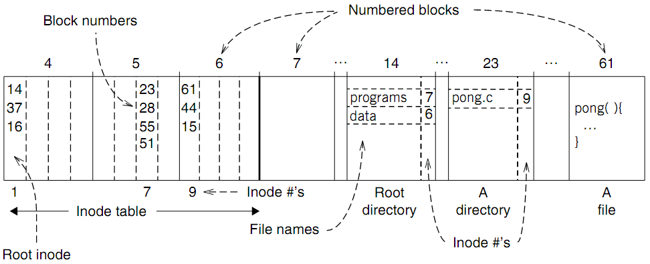
An Example: Find Blocks of "/programs/pong.c"
这里要注意，inode中存储的是此文件对应的block id，
block中存储的是实际内容(regular file)或者inode num
和name的映射(directory).
Root Dir的inode编号为1

Slide 30
An Example: Find Blocks of "/programs/pong.c"
'/' root directory: inode is 1

Slide 31
An Example: Find Blocks of "/programs/pong.c"
Find the first directory in '/' by block number

Slide 32
An Example: Find Blocks of "/programs/pong.c"
Find '/programs' by comparing name

Slide 33
An Example: Find Blocks of "/programs/pong.c"
Find '/programs' inode by its inode number 7

Slide 34
An Example: Find Blocks of "/programs/pong.c"
Find the first file in '/programs/'

Slide 35
An Example: Find Blocks of "/programs/pong.c"
Find '/programs/pong.c' by comparing its name

Slide 36
An Example: Find Blocks of "/programs/pong.c"
Find inode of '/programs/pong.c' by the inode number 9

Slide 37
An Example: Find Blocks of "/programs/pong.c"
Find block number of '/programs/pong.c'

Slide 38
An Example: Find Blocks of "/programs/pong.c"
Find data of block 61 by its block number
And data of block 44 & 15

Slide 39
Directly Dump a Directory
-ai：all inodes
$ ls -ai temp
7536909 . 7530417 .. 7536939 a 7536940 b 7536941 c 7536942 d
$ echo “obase=16;7536909;7530417;7536939;7536940;7536941;7536942" | bc
73010D 72E7B1 73012B 73012C 73012D 73012E
$ sudo /sbin/debugfs /dev/sda1
debugfs 1.43.4 (31-Jan-2017)
debugfs: dump temp temp.out
debugfs: quit
$ xxd temp.out
0000000: 0d01 7300 0c00 0102 2e00 0000 b1e7 7200 ..s...........r.
0000010: 0c00 0202 2e2e 0000 2b01 7300 0c00 0101 ........+.s.....
0000020: 6100 0000 2c01 7300 0c00 0101 6200 0000 a...,.s.....b...
0000030: 2d01 7300 0c00 0101 6300 0000 2e01 7300 -.s.....c.....s.
0000040: c40f 0101 6400 0000 0000 0000 0000 0000 ....d...........
0000050: ...

Slide 40
Directly Dump a Directory
struct ext4_dir_entry {
uint32_t inode_number;
uint16_t dir_entry_length;
uint8_t file_name_length;
uint8_t file_type;
char name[EXT4_NAME_LEN];
}
0d01 7300 0c00 0102 2e00 0000
b1e7 7200 0c00 0202 2e2e 0000
2b01 7300 0c00 0101 6100 0000
2c01 7300 0c00 0101 6200 0000
2d01 7300 0c00 0101 6300 0000
2e01 7300 c40f 0101 6400 0000
File Type
0x0: Unknown
0x1: Regular file
0x2: Directory
0x3: Character device file
0x4: Block device file
0x5: FIFO
0x6: Socket
0x7: Symbolic link
0d01 7300 0c00 0102 2e00 0000
0d01 7300: inode number
0c00: entry length is 12 bytes
01: file name length is 1 byte
01: file type is regular file
2e00 0000: file name (2e -> ".")

Slide 41
L7: Symbolic Link Layer
Symbolic link
Absolute path
File
name
Inode num
File
(inode)
Block num
Disk
Block
Path name
不同盘上面的inode编号以及分布都是
不同的，所以通过硬link无法直接访问不
同文件系统的文件，因为namespace不同。
Name files on other disks
Inode is different on other disks
Supports to attach new disks to the name space
Two options
Make inodes unique across all disks (not good)
Create synonyms for the files on the other disks
Introducing layer 7: soft link (symbolic link)
SYMLINK
Add another type of inode
正是因为symbolic link只需关联
文件名，并且其本身的inode和
映射文件的inode不同，所以
可以实现跨文件系统的映射。
实际上soft Link是通过文件名而不是inode num
做的映射。即symbolic link文件中存储的内容
就是其映射到的文件的名称或路径。

Slide 42
Directly Dump a Symbolic Link
$ ln -s "/tmp/abc" s-link
$ ls –l s-link
7536945 lrwxrwxrwx 1 xiayubin 8 Sep 20 08:01 s-link -> /tmp/abc
$ readlink s-link
/tmp/abc
$ cat s-link
cat: slink: No such file or directory (因为此时/tmp/abc文件并不存在)
$ echo "hello, world" > /tmp/abc
$ cat s-link
hello, world
What does "8" means?
File size
s-link本身就是一种文件，
并且其不会要求其软连接
到的文件一定要存在。

Slide 43
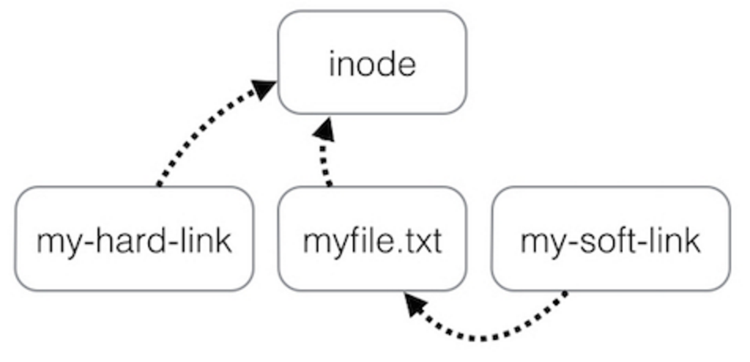
Two Types of Links (Synonyms)
By inode number
By inode number
By file name

Slide 44
Sidebar: Notice the Context Change
Another interesting behavior of soft link
There is a directory: "/Scholarly/programs/www"
The root directory contains a soft link
"/CSE-web" -> "/Scholarly/programs/www"
Run following commands
cd CSE-web
cd ..
What is the current directory? Why?
".." is resolved in a new default context: by bash, not file system
结果是cd ..后结果为‘/’,即根目录，因为..会由bash直接解析
而不是通过对于link的解析来得到最后的结果(即如果通过
link来解析的话应该是/Scholary/programs)

Slide 45
Sidebar: Notice the Context Change
The bash tries to be "human-friendly"
When you cd /into/a/symlink/, the shell remembers the old location (in $OLDPWD) and will use that directory when you cd .. under the assumption that you want to return to the directory you were just in
If you want to use the real .., then you must also use "cd -P .." The -P option says to use the physical directory structure instead of following symbolic links (see also the -P option to the set built-in command); the -L option forces symbolic links to be followed.
$ cd
$ cd a/b/symlink
$ cd -P ..
$ pwd -P
/home/sarnold
$

Slide 46
Summary of File System's 7 Layers
File name is not part of a file
Name is not a part of an inode
Name is data of a directory, and metadata of a file system
One inode can have several names (hard links)
Hard links are equal
If a file has two names, both are links (instead of "a link and a name")
Directory size is small
Only mapping from name to inode number
The term "folder" is somewhat misleading

